Slide 1
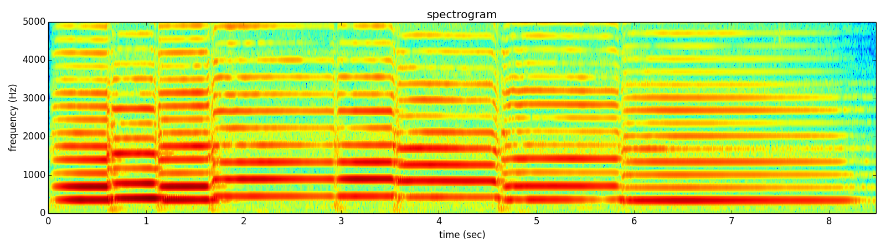
Notes:
This is the spectrogram of what I played.

Slide 2
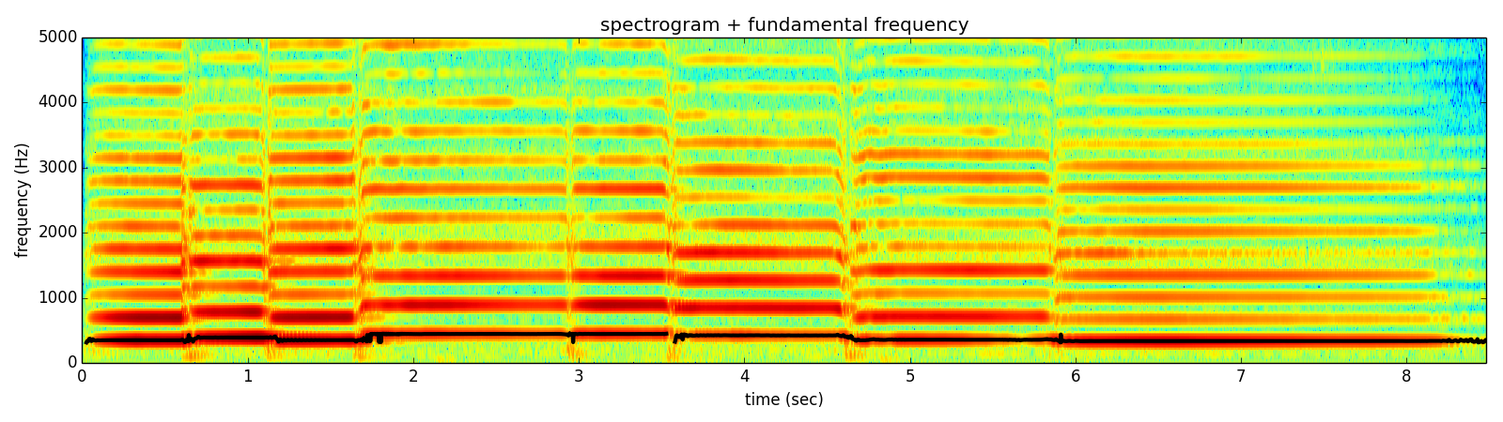
Notes:
From the spectrum we can identify the fundamental frequency of the sound, which can be synthesized as a sinewave.

Slide 3
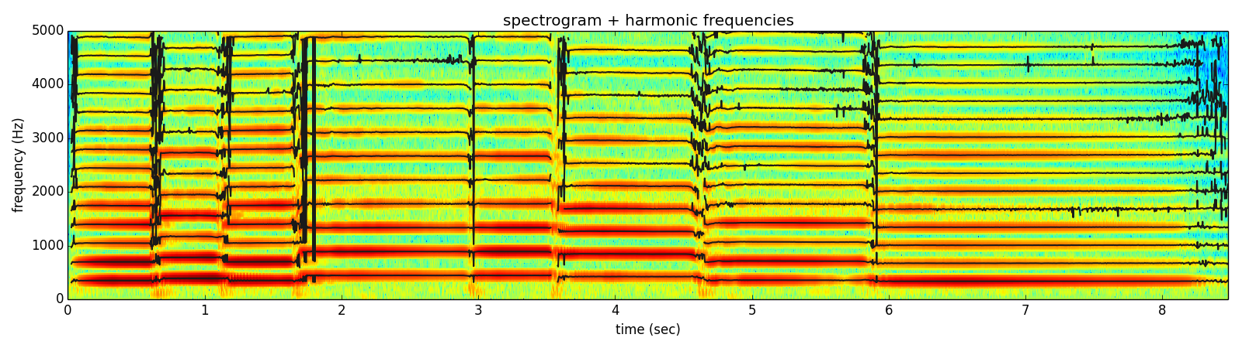
Notes:
We can then detect the harmonics of that fundamental frequency. But there is more to the sound than just the harmonics.

Slide 4
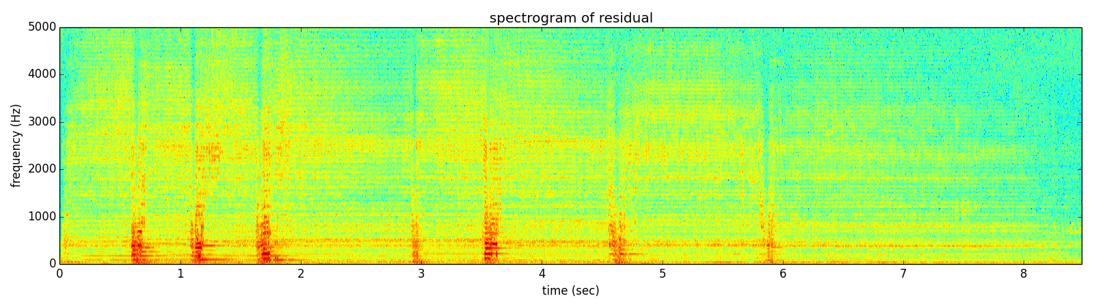
Notes:
If we subtract them from the original sound we can get the spectrum of what is left, and listen to it.

Slide 5
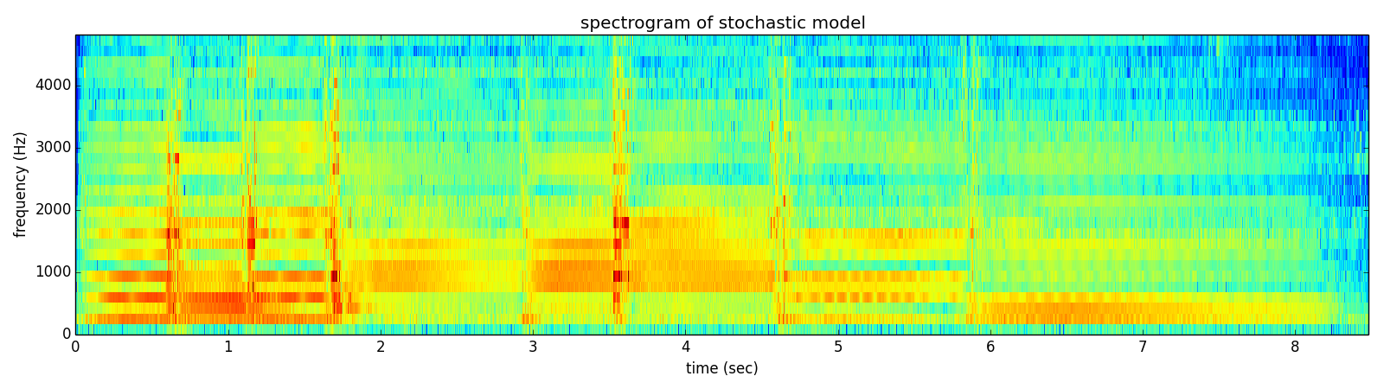
Notes:
This residual signal can be approximated with an stochastic model,

Slide 6
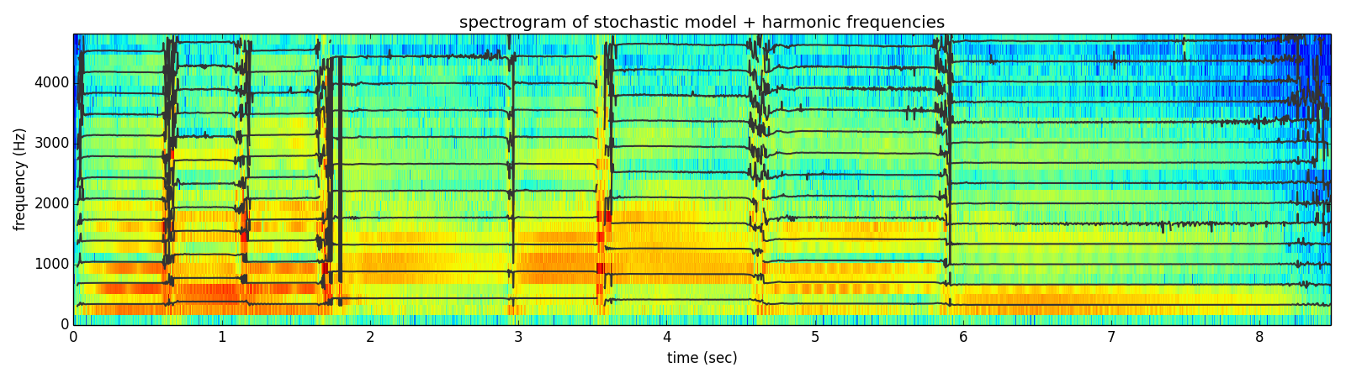
Notes:
and we can put it together with the harmonics to obtain a representation with which we can do many things,

Slide 7
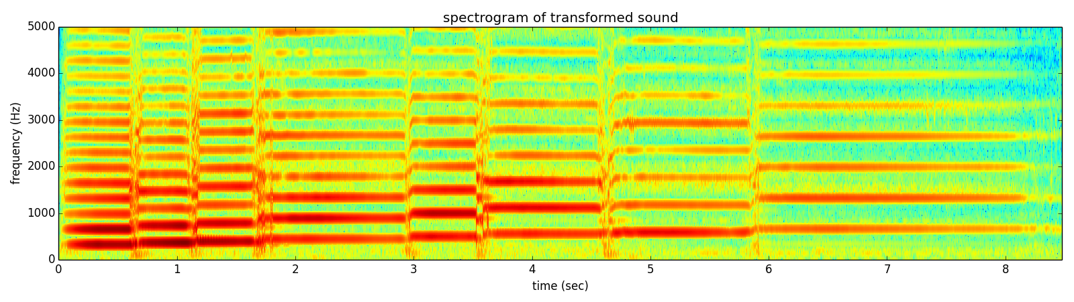
Notes:
like synthesizing a sound with the notes changed,

Slide 8
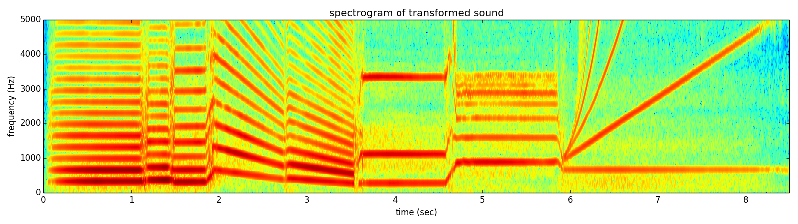
Notes:
or we can generate some weird sound like this one,

Slide 9
Notes:
The number of possible transformations is infinite; only bounded by your creativity.

